Slide 1
NCI Data Management and progress towards enabling Transdisciplinary access
Ben Evans, C. Trenham & K. Druken, and others at NCI A. Moise, L. Hanson, T. Erwin, L. Wilson
P. Petrelli, D. Monselesan, F. Delage

Slide 2
NCI requirements
Models generated by ACCESS community, generated at NCI
ACCESS-CM1/CM2, ACCESS-ESM
NWP, Seasonal Climate, Ocean, Land, Data Assimilation
Other physical systems (Waves, Cyclones, volcanic ash,
water mgt/shelf/reef, ecosystems)
NCI provides HPC/HPDA environment for modelling, observational products, data analysis and viz
Other communities using the same infrastructure (and increasing interest) for their analysis within performant in-situ environment
Manage the data with confidence (QA and provenance)

Slide 3
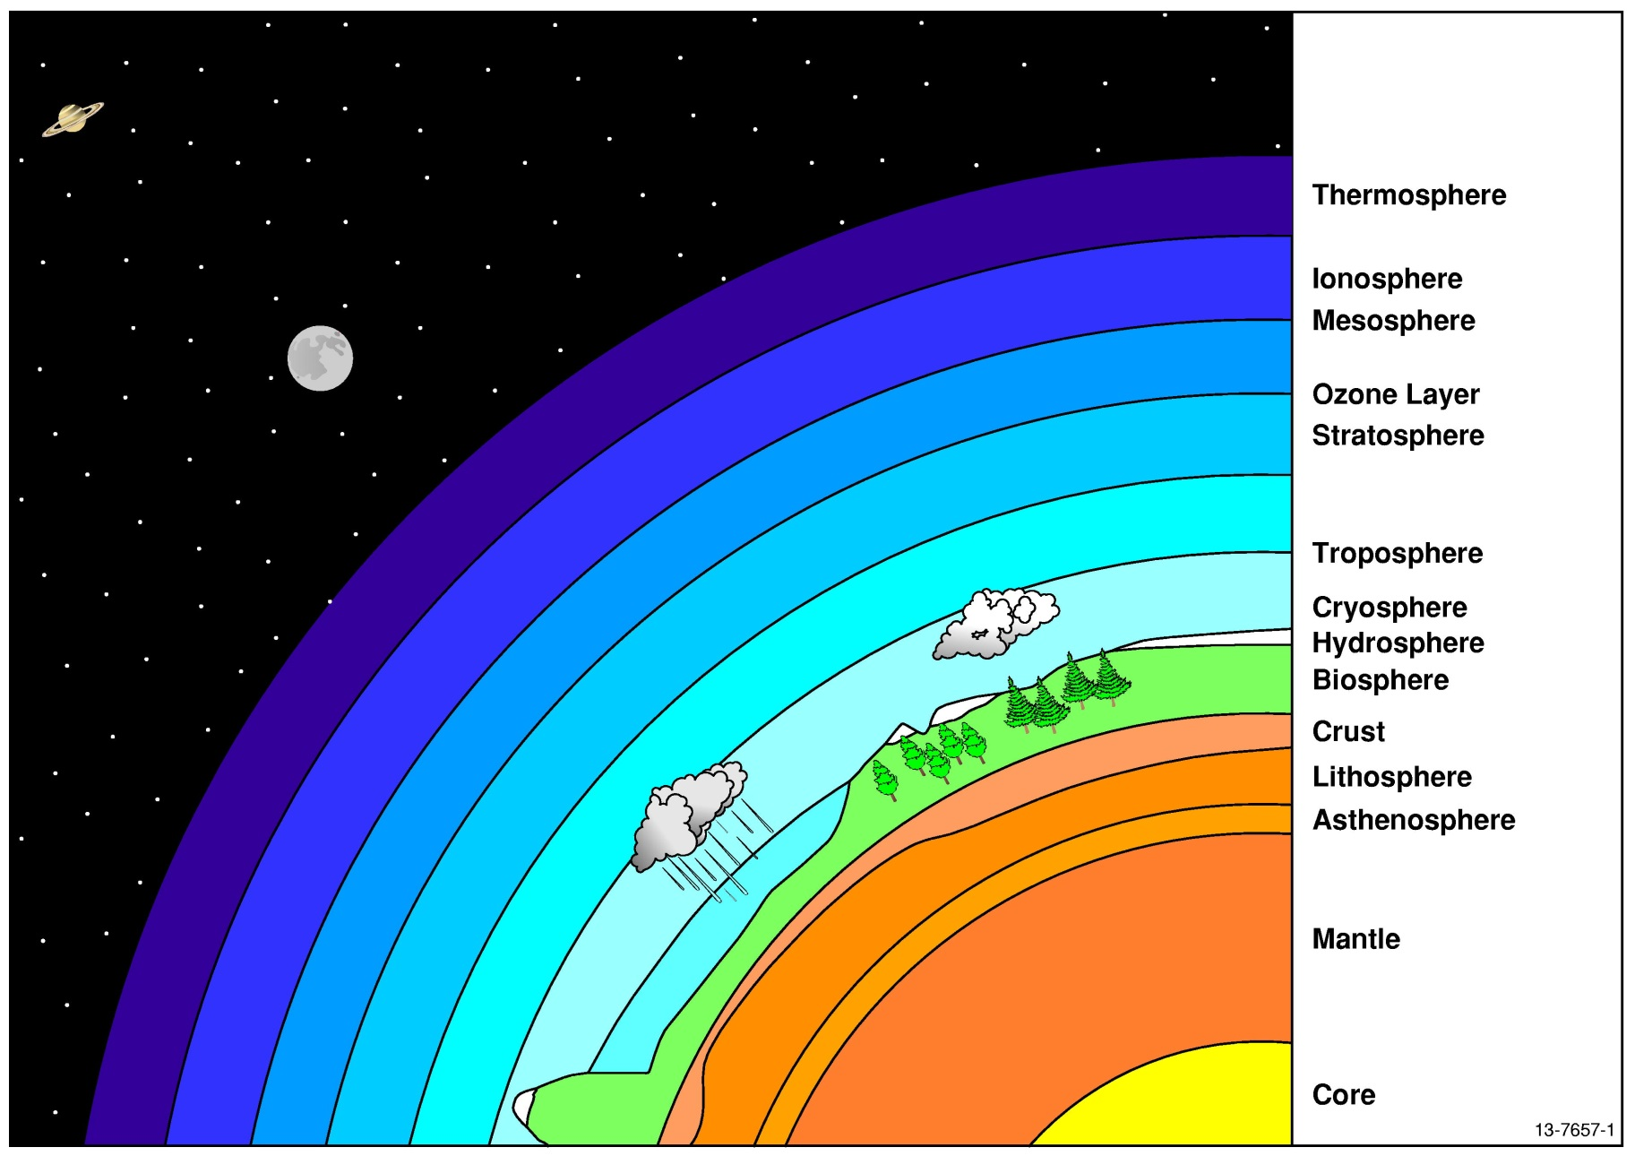
10+ PB of Data for Interdisciplinary Science
Astronomy (Optical)
200 TB
Weather
340 TB
CMIP5 3PB
Atmosphere
2.4 PB
Earth Observ. 2 PB
Bathy, DEM
100 TB
Water
Ocean
1.5 PB
Marine Videos 10 TB
Geophysics 300 TB
GA
CSIRO
ANU
Other National
Inter-national

Slide 4
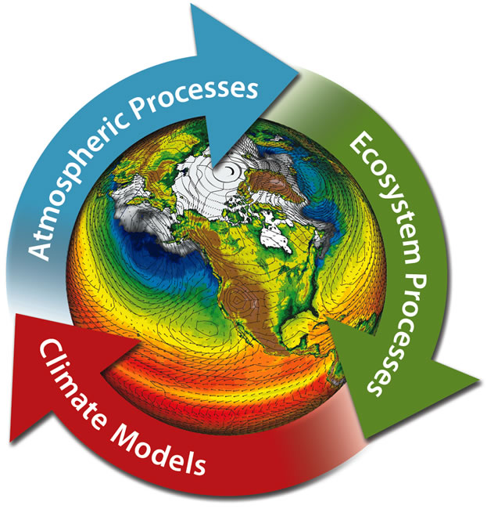
10+ PB of Data for Interdisciplinary Science
Astronomy (Optical)
200 TB
Weather
340 TB
CMIP5 3PB
Atmosphere
2.4 PB
Earth Observ. 2 PB
Bathy, DEM
100 TB
Water
Ocean
1.5 PB
Marine Videos 10 TB
Geophysics 300 TB
GA
CSIRO
ANU
Other National
Inter-national

Slide 5
Challenge: Migration to Transdisciplinary data
Intradisciplinary: working within a single discipline.
Crossdisciplinary: viewing one discipline from the perspective of another.
Multidisciplinary: people from different disciplines working together, each drawing on their disciplinary knowledge.
Interdisciplinary: integrating knowledge and methods from different disciplines, using a real synthesis of approaches.
Transdisciplinary: creating a unity of intellectual frameworks beyond the disciplinary perspectives.
Ref: Alexander Refsum Jensenius
http://www.arj.no/2012/03/12/disciplinarities-2/

Slide 6
National Environment Research Data Collections (NERDC)
http://geonetwork.nci.org.au.au
1. Climate/ESS Model Assets and Data Products
2. Earth and Marine Observations and Data Products
3. Geoscience Collections
4. Terrestrial Ecosystems Collections
5. Water Management Collections
Data Collections | Approx. Capacity
CMIP5, CORDEX | ~2 Pbytes
ACCESS products | 2.4 Pbytes
LANDSAT, MODIS, VIIRS, AVHRR, INSAR, MERIS | 1.5 Pbytes
Digital Elevation, Bathymetry, Onshore Geophysics | 700 Tbytes
Seasonal Climate | 700 Tbytes
Bureau of Meteorology Observations | 350 Tbytes
Bureau of Meteorology Ocean-Marine | 350 Tbytes
Terrestrial Ecosystem | 290 Tbytes
Reanalysis products | 100 Tbytes

Slide 7
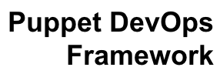
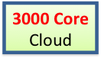

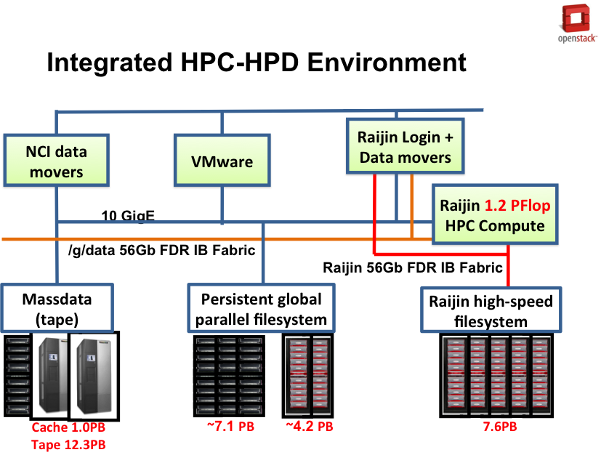


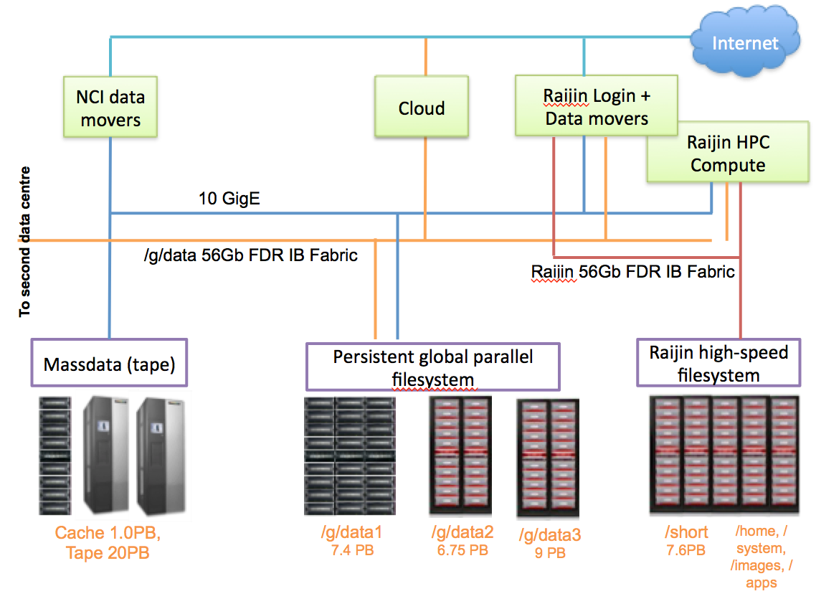
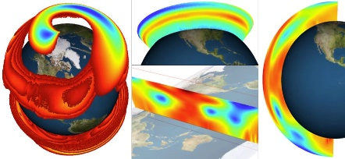



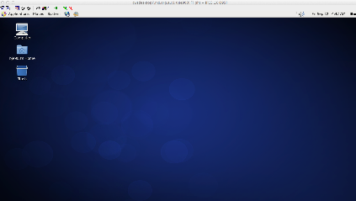
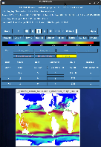

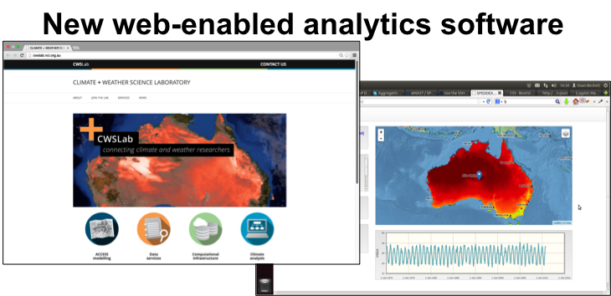
Integrated Scientific Computing Environment
Data Services
Server-side analysis and visualization
THREDDS
VDI: Cloud scale user desktops on data
10PB+ Research Data
Web-time analytics software
Notes:
The National Computational Infrastructure (NCI) has co-located a priority set of national data assets within a HPC research platform. This powerful in-situ computational platform has been created to help serve and analyse the massive amounts of data across the spectrum of environmental collections – in particular the climate, observational data and geoscientific domains. This paper examines the infrastructure, innovation and opportunity for this significant research platform.
There is a framework to the cloud – Puppet DevOps Framework

Slide 8
Introducing the National Environmental Data Interoperability Research Platform (NERDIP)
Biodiversity & Climate Change VL
Climate & Weather Systems Lab
eMAST Speddexes
eReefs
AGDC VL
All Sky Virtual Observatory
VGL
VHIRL
Open Nav Surface
Globe Claritas
Workflow Engines, Virtual Laboratories (VL’s), Science Gateways
Ferret, NCO, GDL, GDAL, GRASS, QGIS
Fortran, C, C++, MPI, OpenMP
Python, R, MatLab, IDL
Visualisation
Drishti
ANDS/RDA Portal
AODN/IMOS Portal
TERN Portal
Data. gov.au
Digital Bathymetry & Elevation Portal
Models
AuScope Portal
Tools Data Portals
National Environmental Research Data Interoperability Platform (NERDIP)
Services Layer (expose data models & semantics)
Fast “whole-of-library” catalogue
Direct Access
Open DAP
OGC WMS
OGC WFS
OGC WPS
OGC SOS
OGC W*S
RDF, LD
OGC WCS
Metadata Layer
netCDF-CF
HDF-EOS
ISO 19115, RIF-CS, DCAT, etc.
Data Library Layer 1
netCDF-4 Climate/Weather/Ocean
netCDF-4 EO
Libgdal EO
LAS LiDAR
FITS
Airborne Geophysics Line data
SEG-Y
BAG
HP Data Library Layer 2
HDF5 MPI-enabled
HDF5 Serial
Lustre
Other Storage (options)

Slide 9
NERDIP: Enabling Multiple Ways to Interact with the Data
Infrastructure to Lower Barriers to Entry
Biodiversity & Climate Change VL
Climate & Weather Systems Lab
eMAST Speddexes
eReefs
AGDC VL
All Sky Virtual Observatory
VGL
VHIRL
Open Nav Surface
Globe Claritas
Workflow Engines, Virtual Laboratories (VL’s), Science Gateways
Ferret, NCO, GDL, GDAL, GRASS, QGIS
Ace Users
Data Discovery
Models
Fortran, C, C++, MPI, OpenMP
Python, R, MatLab, IDL
Visualisation
Drishti
ANDS/RDA Portal
AODN/IMOS Portal
TERN Portal
Data. gov.au
Digital Bathymetry & Elevation Portal
AuScope Portal
Tools Data Portals
National Environmental Research Data Interoperability Platform (NERDIP)
Services Layer (expose data models & semantics)
Fast “whole-of-library” catalogue
Direct Access
Open DAP
OGC WMS
OGC WFS
OGC SOS
OGC W*S
RDF, LD
OGC WPS
OGC WCS
Metadata Layer
netCDF-CF
HDF-EOS
ISO 19115, RIF-CS, DCAT, etc.
Data Platform
Data Library Layer 1
netCDF-4 Climate/Weather/Ocean
netCDF-4 EO
Libgdal EO
LAS LiDAR
FITS
Airborne Geophysics Line data
SEG-Y
BAG
HP Data Library Layer 2
HDF5 MPI-enabled
HDF5 Serial
Lustre
Other Storage (options)

Slide 10
CMIP5 @ NCI
For the most part, community use the data stored at NCI
Data volumes (CMIP5) stored at NCI
~1.3PB replicated data (600TB community, 700TB by DTN)
~900TB locally run model data (ACCESS, CSIRO-Mk3.6)
NCI CMIP5 “authoritative” data
ACCESS1.0: 11,931 files (8 expts)
ACCESS1.3: 19,464 files (13 expts)
CSIRO-Mk3.6.0: 96,305 files (16 expts)
CMIP5: 100% of files are netCDF3 format, comply to the CF1.4 convention (as per CMIP5 QC.)

Slide 11
CMIP6 ESGF planning
NCI will publish all the Australian data in the MIPS
we will republish ACCESS1.0, ACCESS1.3, CSIRO-Mk3.6.0, and GeoMIP (CSIRO-Mk3L)
NCI will take responsibility for QA/QC, DOI minting, provenance capture.
CF conformance, Controlled vocabs, Documentation
(Re)Publish replica data (if we should do at all)?
Not until we have confidence and have manageable ESGF replication process
Superficially, expect that we need to plan to store the data twice, but haven’t planned for that (once for ESGF; once for the users/models).
May need to do more work on the library to solve.

Slide 12
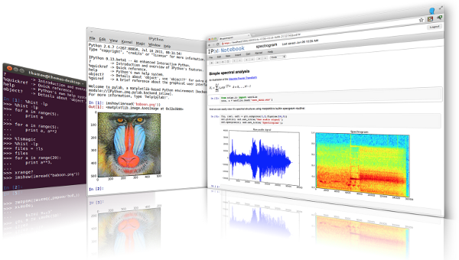




Easy-access analysis environments
Management of iPython Notebooks
VDI – frictionless environment via secure connection to NCI

Slide 13
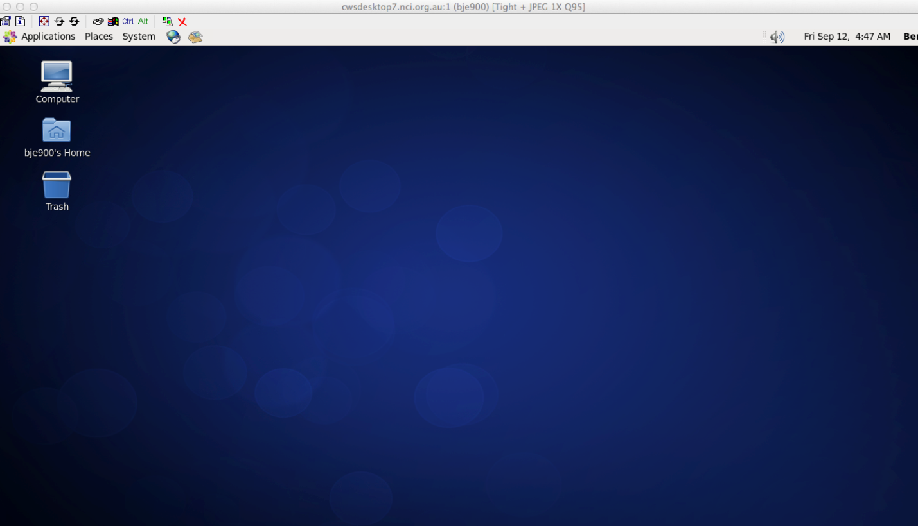
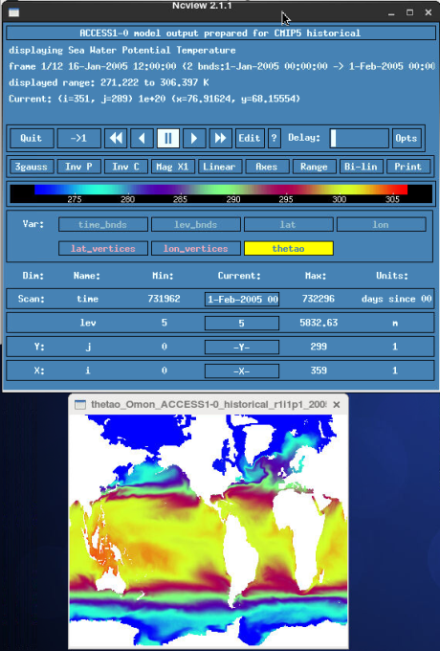
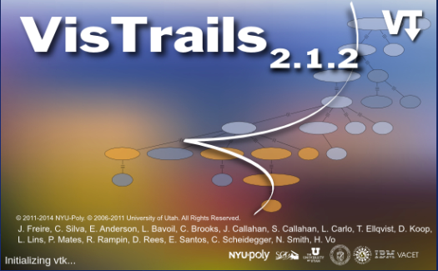
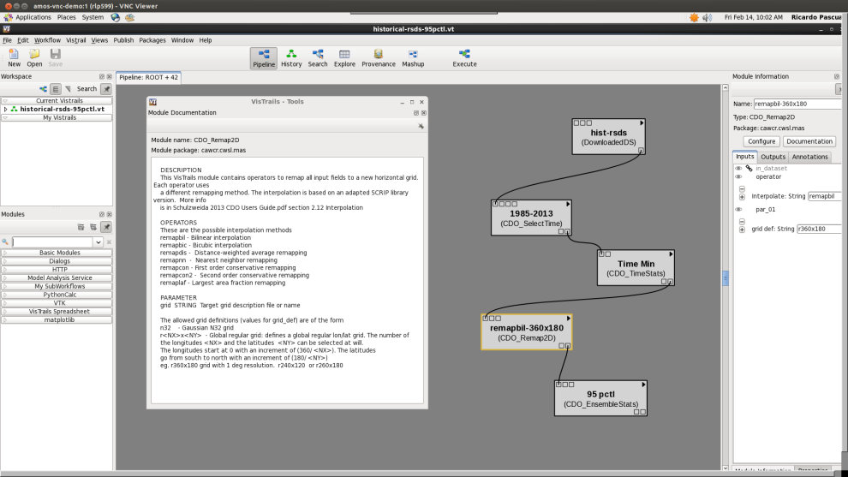

VDI session on NCI HPC cloud: frictionless environment

Slide 14
Data formats to NetCDF4; ESGF management issues
CMIP6: NetCDF4/HDF5
Need to move forward, backward compatibility is counter-productive
Tools need to catch up;
Python, Matlab etc already support netCDF4.
Issues with managing data for users
Better pack data for intended usage
Some tricks may be possible at the HDF5 library
Changing chunking or compression will break the checksums of data

Slide 15
Trade off of performance for storage capacity
Read Throughput (MB/s)
Source file (19 MB)
Normal file (121 MB)
Transfer Count | 1× 5500 | 5× 5500 | 10× 5500 | 20× 5500 | 40× 5500 | 55× 5500 | 100× 5500 | 550× 5500 | 1000× 5500 | 5500× 5500
Transfer Size | 22kB | 110KB | 220KB | 440KB | 880KB | 1.21MB | 2.2MB | 12.1MB | 22MB | 121MB
Raijin (src) | 182.39 | 229.19 | 216.08 | 218.45 | 220.58 | 220.74 | 222 | 203.86 | 192.56 | 189.49
Vdi (src) | 199.8 | 248.23 | 235.42 | 238.15 | 239.28 | 241.25 | 228.93 | 219.08 | 217.09 | 220.75
raijin (nrm) | 479.77 | 790.84 | 804.79 | 848.09 | 888.82 | 887.62 | 889.31 | 800.65 | 710.48 | 544.84
vdi (nrm) | 1473.45 | 3965.39 | 4521.17 | 5182.22 | 5785.31 | 4972.67 | 5898.41 | 3818.48 | 3162.54 | 2066.02
Intelligent organisation of the data can close the gap.
Different patterns of access can make the access performance worse.
Better tuning for common/important use needs.
Potential to store compressed data twice (with different packing) if trade-off is justifiable/manageable.

Slide 16
Serial Write Throughput

Slide 17
Serial Read Throughput

Slide 18
Low performance when using default parameters
Parallel Write Throughput
MPI size = 16
Stripe size =1M
Block size = 8G
Transfer size = 32M

Slide 19
Low performance when using default parameters
Parallel Read Throughput
MPI size = 16
Stripe size =1M
Block size = 8G
Transfer size = 32M

Slide 20
Simple Comparison of File format access latency
and compression

Slide 21
Subset Access – compression, subsetting and caches
Chunk shape: 1100×1100
Subset shape: 1×5500,275×275,1100×1100

Slide 22
End user community issues for CMIP
Analyses require input data to be consistent format
Errata / Unreported problems
CF compliance / conventions
Different conventions in use (start date, calendars, grids, dimension bounds)
Overlapping time periods
CMIP5 version management was a serious problem
Is this data most recent? What does “v2” mean?
Switching to date format versions does not solve this problem, just helps clarify which run data is from
Can’t differentiate between major/minor revisions

Slide 23
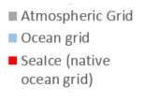
CMIP5 Grid Conventions
Grids vary between models and realms
processing
required for
intercomparison
Model | Atmos | Ocean | Land | SeaIce
ACCESS1.0 | AGCM v1.0: N96 grid-point, 1.875 degrees EW x approx 1.25 degree NS, 38 levels | GFDL MOM4p1: nominal 1.0 degree EW x 1.0 degrees NS, tripolar north of 65N, equatorial refinement to 1/3 degree from 10S to 10 N, cosine dependent NS south of 25S, 50 levels | MOSES2 (atmos grid) | CICE4.1 (ocean grid)
ACCESS1.3 | AGCM v1.0: as above | GFDL MOM4p1: as above | CABLE 1.0 (atmos grid) | CICE4.1 (ocean grid)
CSIRO-Mk3.6.0 | AGCM v7.3.x: T63 spectral, 1.875 degrees EW x approx. 1.875 degrees NS, 18 levels | GFDL MOM2.2: 1.875 degrees EW x approx. 0.9375 degrees NS, 31 levels

Slide 24
Requirements for versioning handling within ESGF
Data sync and versioning
Must now test “real world” data replication using DTNs. Important to test against increase the number of inodes.
Is Synda now tested and ready to evaluate at scale?
Versioning / is this data the latest?
how to manage requests for priority models/variables?
How easy is it to tell if a file is “latest”?
Would non-integer version numbers to allow x.y
indicating major/minor changes help?
How to incorporate feedback about problems / concerns which are not strictly “errata”?
Conceptual Climate Modeling Scientific Workflow
Large Scale Dynamic Citation Management
Download Raw data
10.4225/41/5657A928CDFD6
Static Provenance
Provence Data
Data and Metadata quality assurance
Data ensemble and pre-processing
Provenance Repository
(static and runtime info)
10.4225/41/90D98326KLE4
Data product Version 1
Provence Data
Reprocess using new software/algorithm
Data product Version 2
10.4225/41/5657A928CDFD6
Runtime Provenance
Provence Data
Multiple steps of data ensemble, re-processing…
Data product Version n
10.5072/29/563BE80FC892D
The Provenance Service captures information at each step within the end-to-end workflow, and stores it within the Provenance Repository

Slide 25
Implementing a Provenance System across the NCI
Conceptual Climate Modeling Scientific Workflow
Large Scale Dynamic Citation Management
Conceptual Climate Modeling Scientific Workflow
Large Scale Dynamic Citation Management
Conceptual Climate Modeling Scientific Workflow
Large Scale Dynamic Citation Management
Download Raw data
10.4225/41/5657A928CDFD6
Download Raw data
10.4225/41/5657A928CDFD6
Download Raw data
10.4225/41/5657A928CDFD6
Download Raw data
Static Provenance
Static Provenance
Provence Data
Static Provenance
Provence Data
Data and Metadata quality assurance
Data ensemble and pre-processing
Provence Data
Data and Metadata quality assurance
Data ensemble and pre-processing
Data and Metadata quality assurance
Data ensemble and pre-processing
Data and Metadata quality assurance
Data ensemble and pre-processing
Provenance Repository
(static and runtime info)
Provenance Repository
(static and runtime info)
Provenance Repository
(static and runtime info)
10.4225/41/90D98326KLE4
Data product Version 1
10.4225/41/90D98326KLE4
Data product Version 1
10.4225/41/90D98326KLE4
Data product Version 1
Provence Data
Reprocess using new software/algorithm
Provence Data
Reprocess using new software/algorithm
Provence Data
Reprocess using new software/algorithm
Data product Version 2
10.4225/41/5657A928CDFD6
Data product Version 2
10.4225/41/5657A928CDFD6
Data product Version 2
10.4225/41/5657A928CDFD6
Runtime Provenance
Provence Data
Runtime Provenance
Provence Data
Runtime Provenance
Provence Data
Multiple steps of data ensemble, re-processing…
Multiple steps of data ensemble, re-processing…
Multiple steps of data ensemble, re-processing…
Data product Version n
10.5072/29/563BE80FC892D
Data product Version n
10.5072/29/563BE80FC892D
Data product Version n
10.5072/29/563BE80FC892D
The Provenance Service captures information at each step within the end-to-end workflow, and stores it within the Provenance Repository
The Provenance Service captures information at each step within the end-to-end workflow, and stores it within the Provenance Repository
The Provenance Service captures information at each step within the end-to-end workflow, and stores it within the Provenance Repository

Slide 26
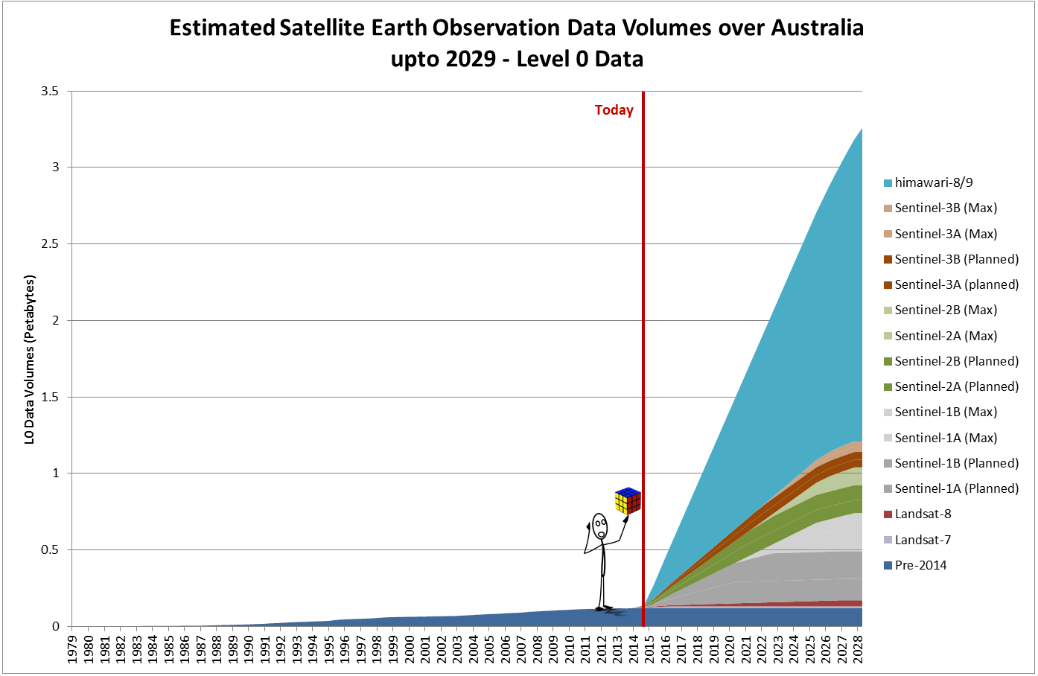
Growth in Satellite Data
c/- Stuart Minchin, Geoscience Australia

Slide 27
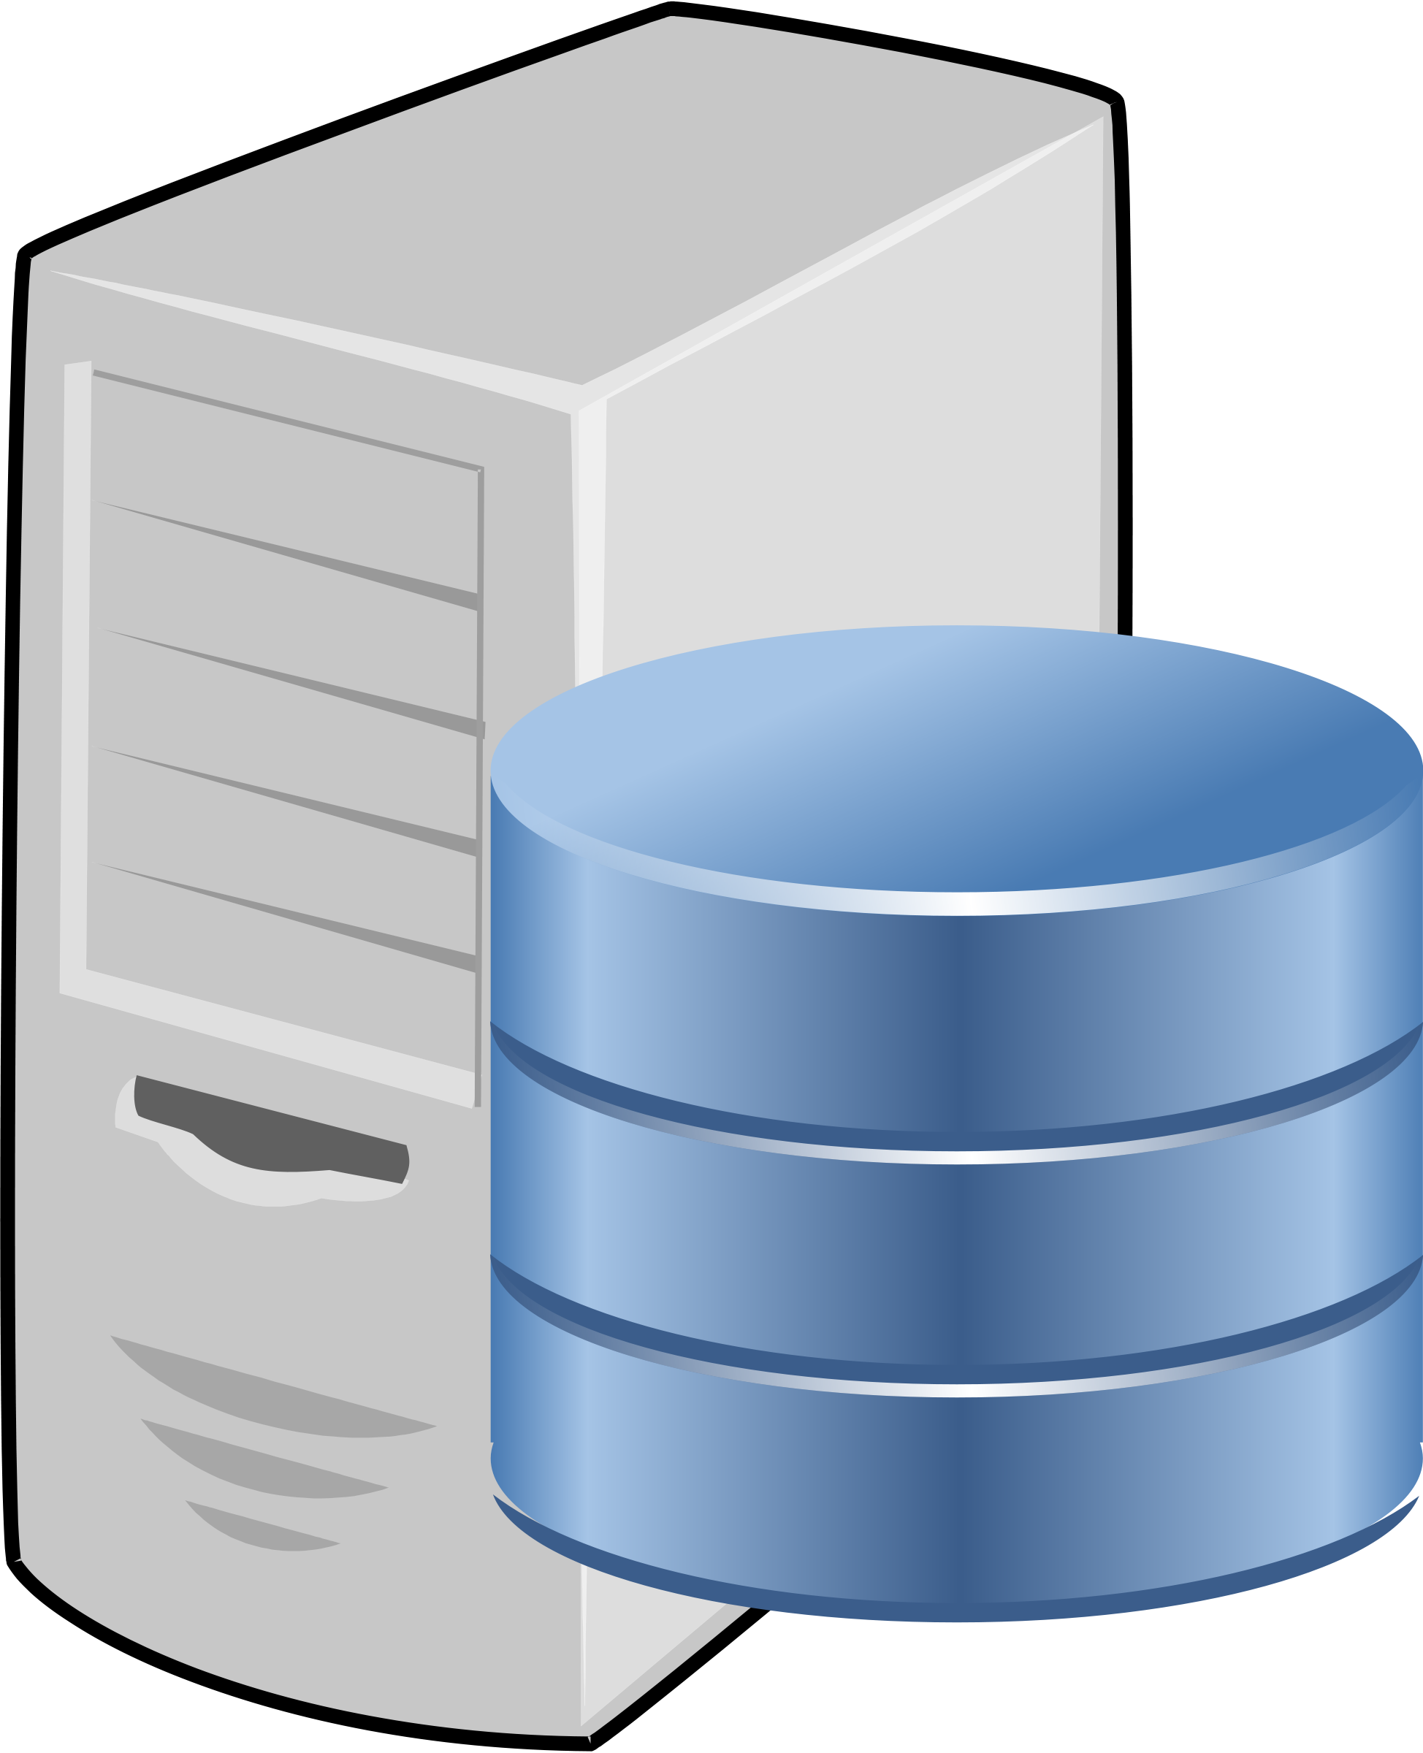
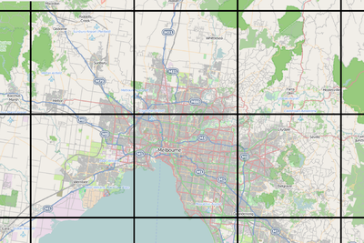
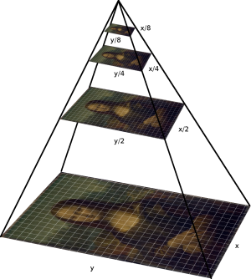
Remapping data - Tile Map Servers
Serving Maps
THREDDS Server
WMTS Server
Client (Browser)
2
1
3
4

Slide 28

Tile Map Servers
Serving Maps
THREDDS Server
WMTS Server
Client (Browser)
2
1
3
4

Slide 29
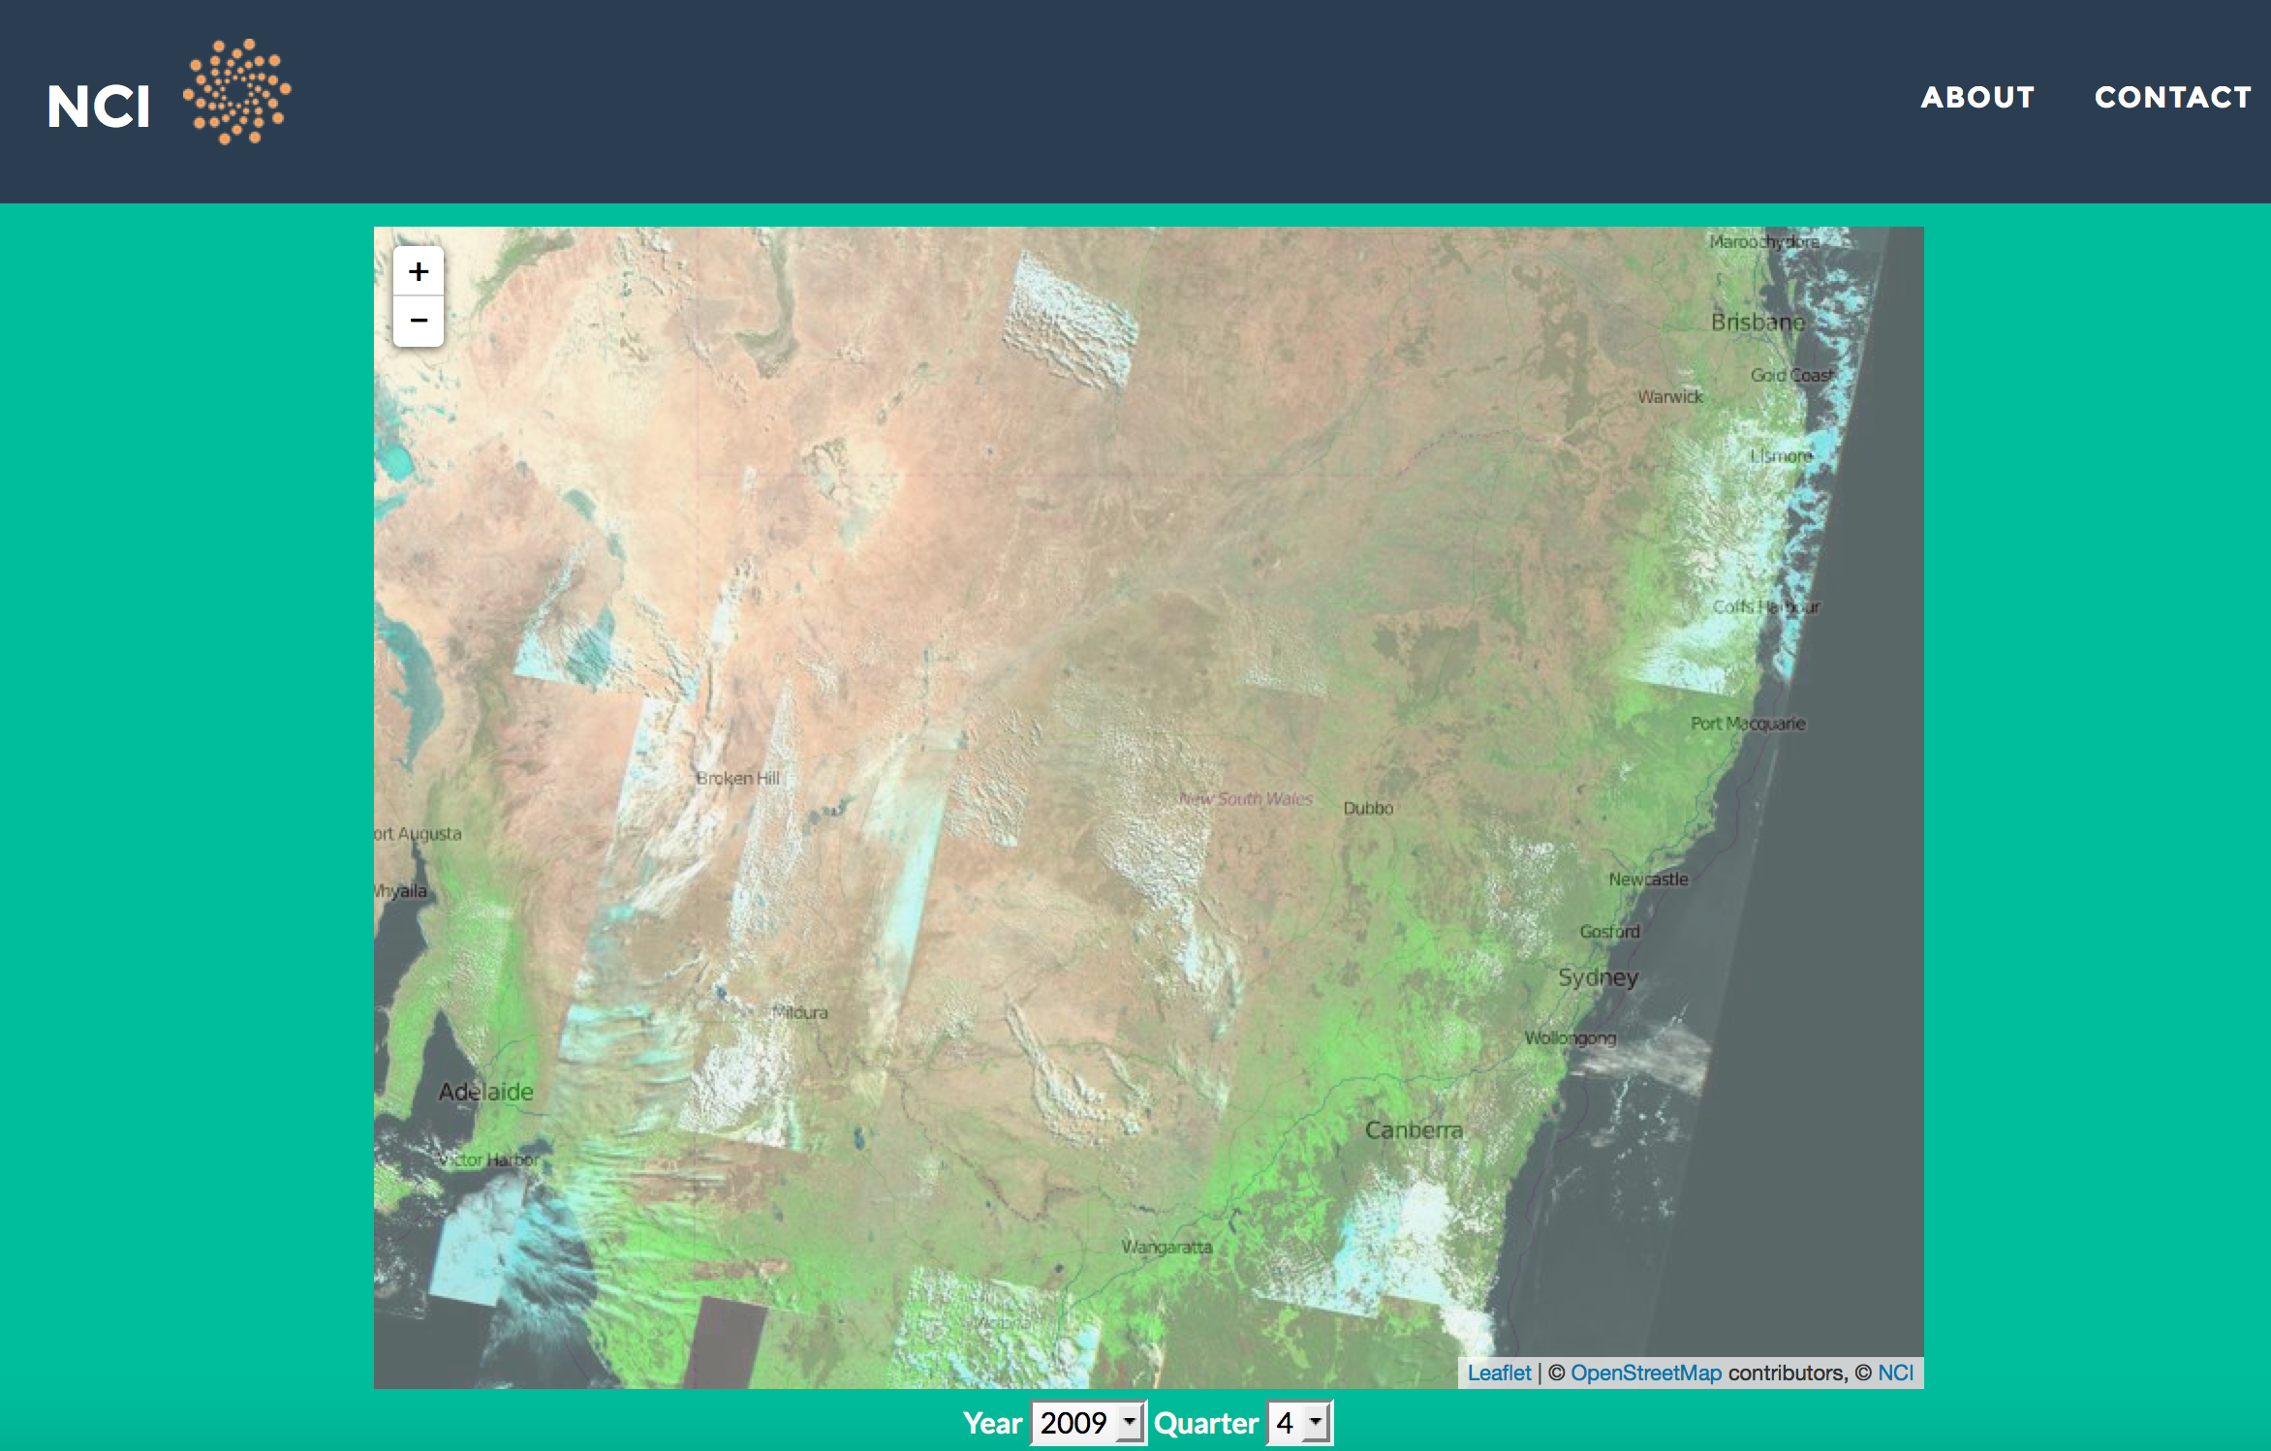
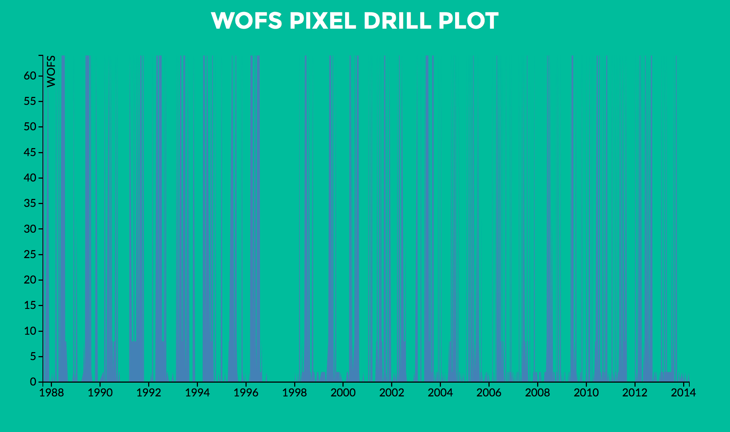
On-the-fly data access and data manipulation
– through apps

Slide 30
Anyway – Summary!
Major items for ESGF we are dependent on ESGF to do:
Deploy and qualify it is working at each site
Fully test this infrastructure
- Quality assurance
Publish the data with DOIs
Relax the requirement on the registration
Replicate the data intelligently and test in operation
Track the data versions
Ensure that the sites can operate (training, confident in operations, ensure quality across the federation)
Data Centres have to deploy the end-user analysis tools
Deploy ESGF data services (TDS, LAS,WPS?), UV-CDAT, etc
Unify the training materials on those tools
Suggest set a date to change focus from developing and make sure that we have infrastructure that is released, robust, documented and sites are confident in operating.

